Slide 1



TIRE CHANGES &
STRATEGY IMPACT in F1
Group 3 - MLDS Data Engineering
Using https://openf1.org/ API

Slide 2

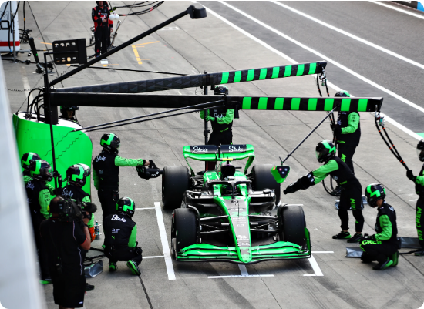
THE COMPLEXITY OF F1
Race outcomes impacted by many FACTORS
F1 races are shaped by a massive interplay of factors—grid positions, car performance, engine modes, ERS usage, track layout, weather, driver skill, and even radom safety-car and race control events
But even within this complexity, pit-stop strategy and tire choices remain one of the most controllable levers teams have.

Slide 3
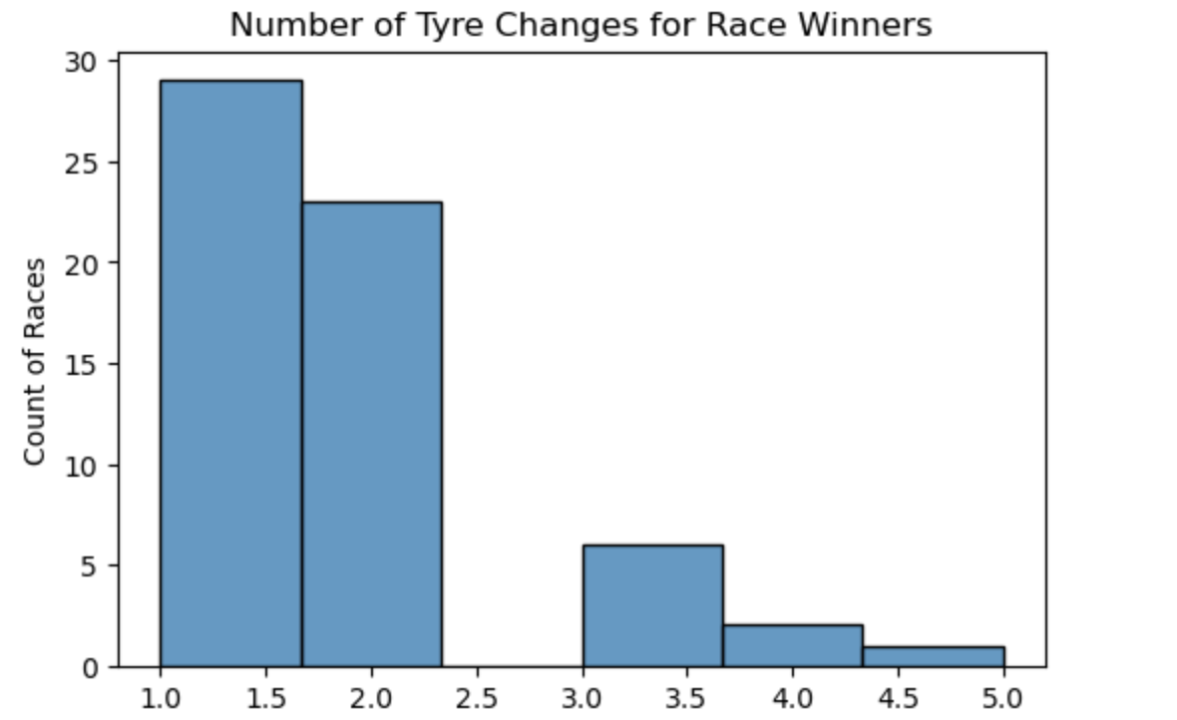
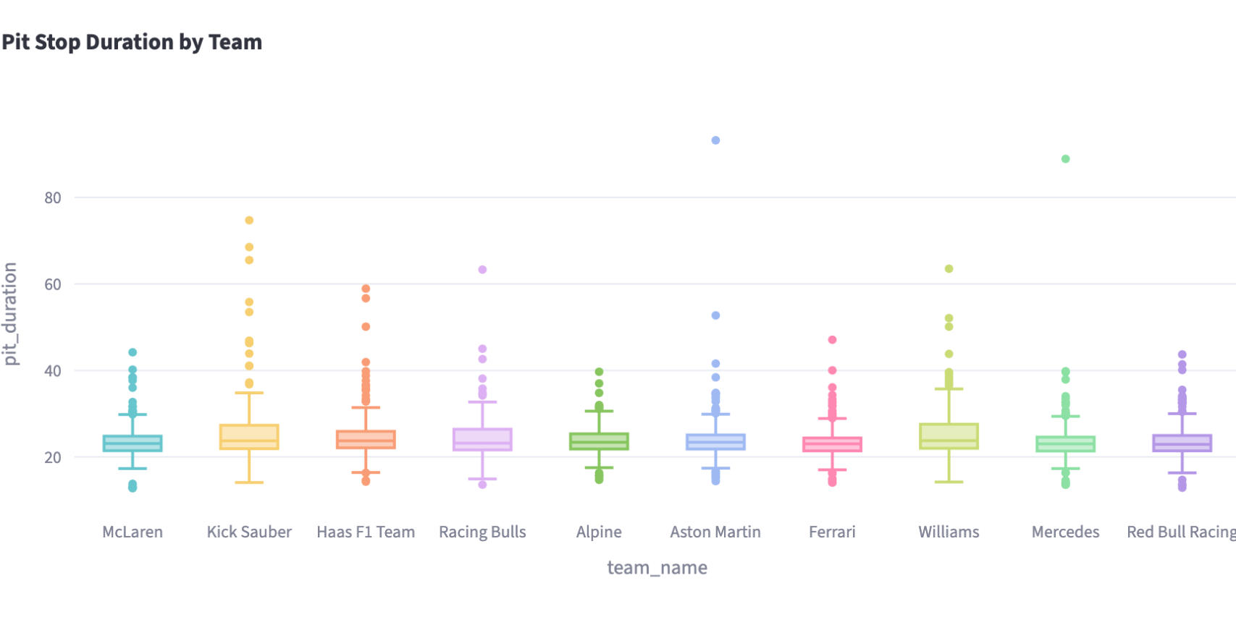
THE CONTROLLABLE LEVER
PIT STOPS & TIRE CHOICES
>
Performance Difference: Soft tyres are fastest but wear quickly, while hard tires are slower but last much longer.
>
The Cost: A pit stop typically costs 10-40 seconds.
>
The Game: Timing the switch to minimize time lost and maximize track position (Undercut/Overcut).
The team aim to quantify how these decisions create or erase gaps.

Slide 4
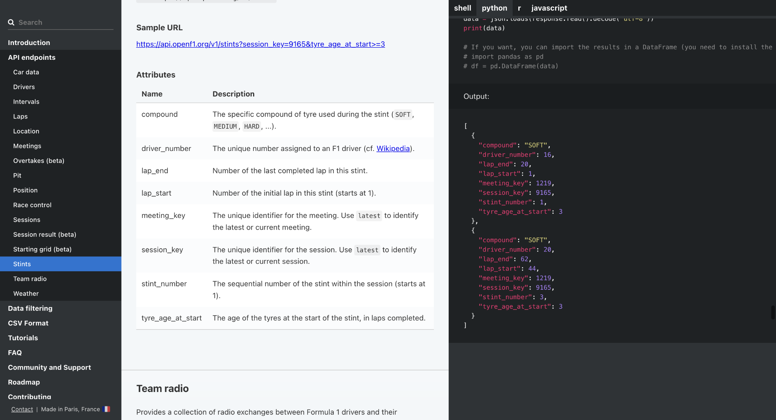
DATA SOURCE: OPENF1 API

Slide 5
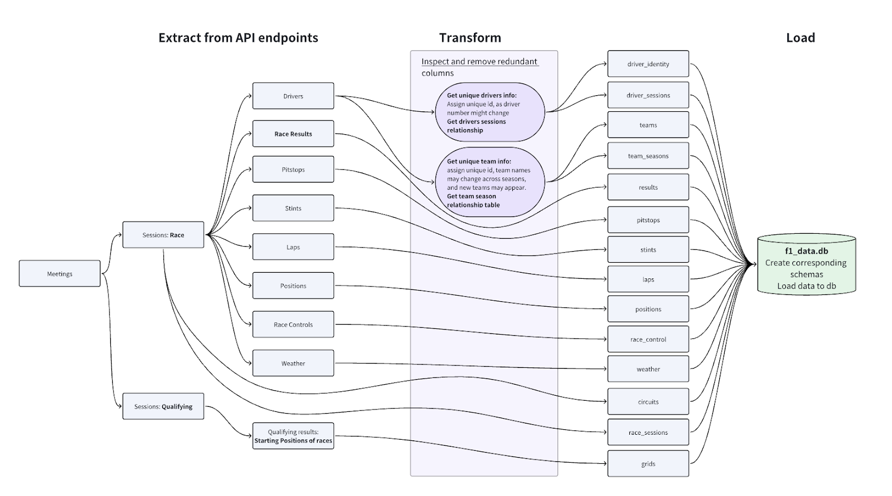
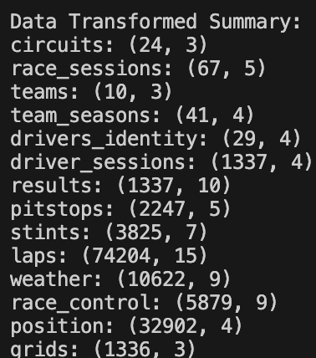
ETL PIPELINE ARCHITECTURE

Slide 6
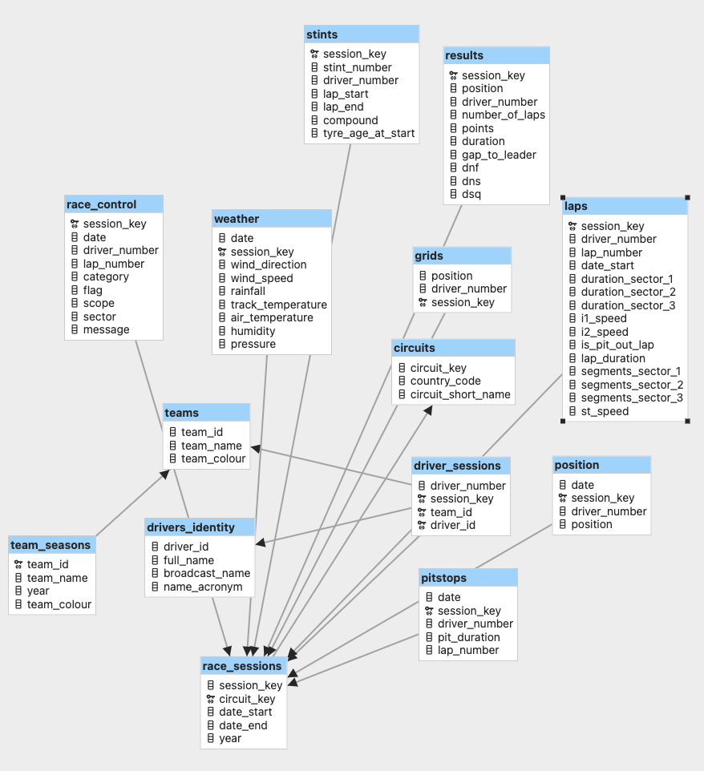
STRUCTURED DATABASE
FROM API ENDPOINTS TO SQLITE DATABASE
The transformation process results in a robust relational schema comprising 15+ tables, keep them independent
>
Core Tables:, race_sessions, Drivers, Teams
>
Event Data: Laps, Pit_Stops, Stints
>
Context: Weather, Circuits
This structure enables complex joins to answer strategic questions.

Slide 7


FEATURE ENGINEERING
STRATEGY METRICS
PERFORMANCE METRICS
>
Tire Sequences: Reconstructing the chain (e.g., Soft → Medium → Hard).
>
Pace Delta: Avg lap time before vs. after pit stop.
>
Position Delta: Grid Position vs. Final Position (The ultimate measure of success).
>
Stop Spacing: Analysis of stint length distribution relative to rivals.

Slide 8
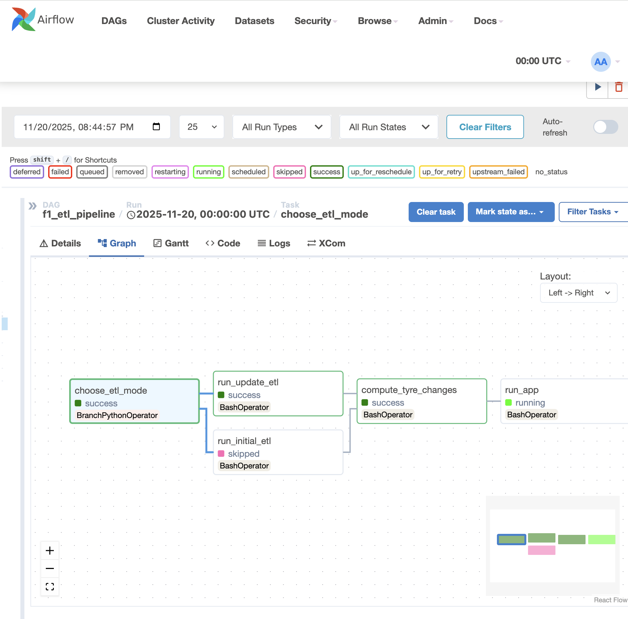
DOCKER AND AIRFLOW
SETTING UP DOCKER AND AIRFLOW
Packaged the full ETL pipeline (scripts, dependencies, environment) into Docker containers.
Orchestrated the workflow with Airflow, managing task dependencies, scheduling, logging, and automatic retries for stability.
Implemented auto-routing in the DAG—the pipeline performs a full load on first run and switches to incremental updates when data already exists.

Slide 9
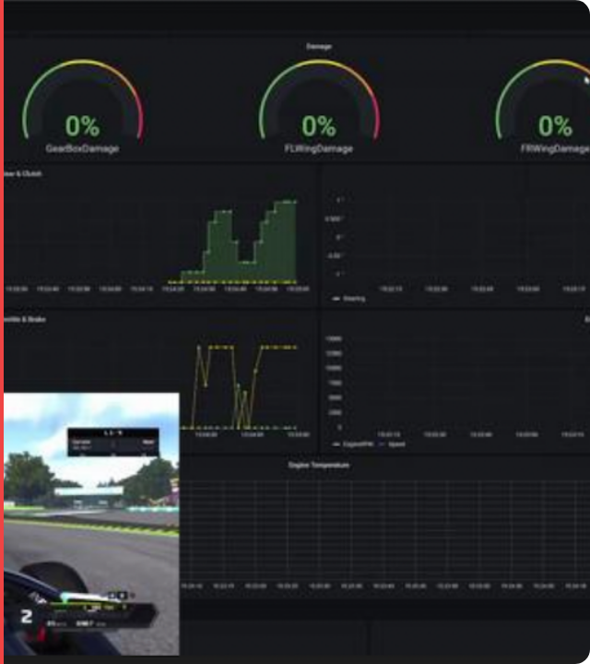
LIVE DEMO
We will now demonstrate the our Streamlit dashboard
>
Timeline Visualization: Driver's full pit-stop timeline.
>
Stint Analysis: Visualizing pace drops and compound transitions.
>
Head-to-Head: Comparing 1-stop vs. 2-stop strategies.
See how the data tells the story of the race.

Slide 10
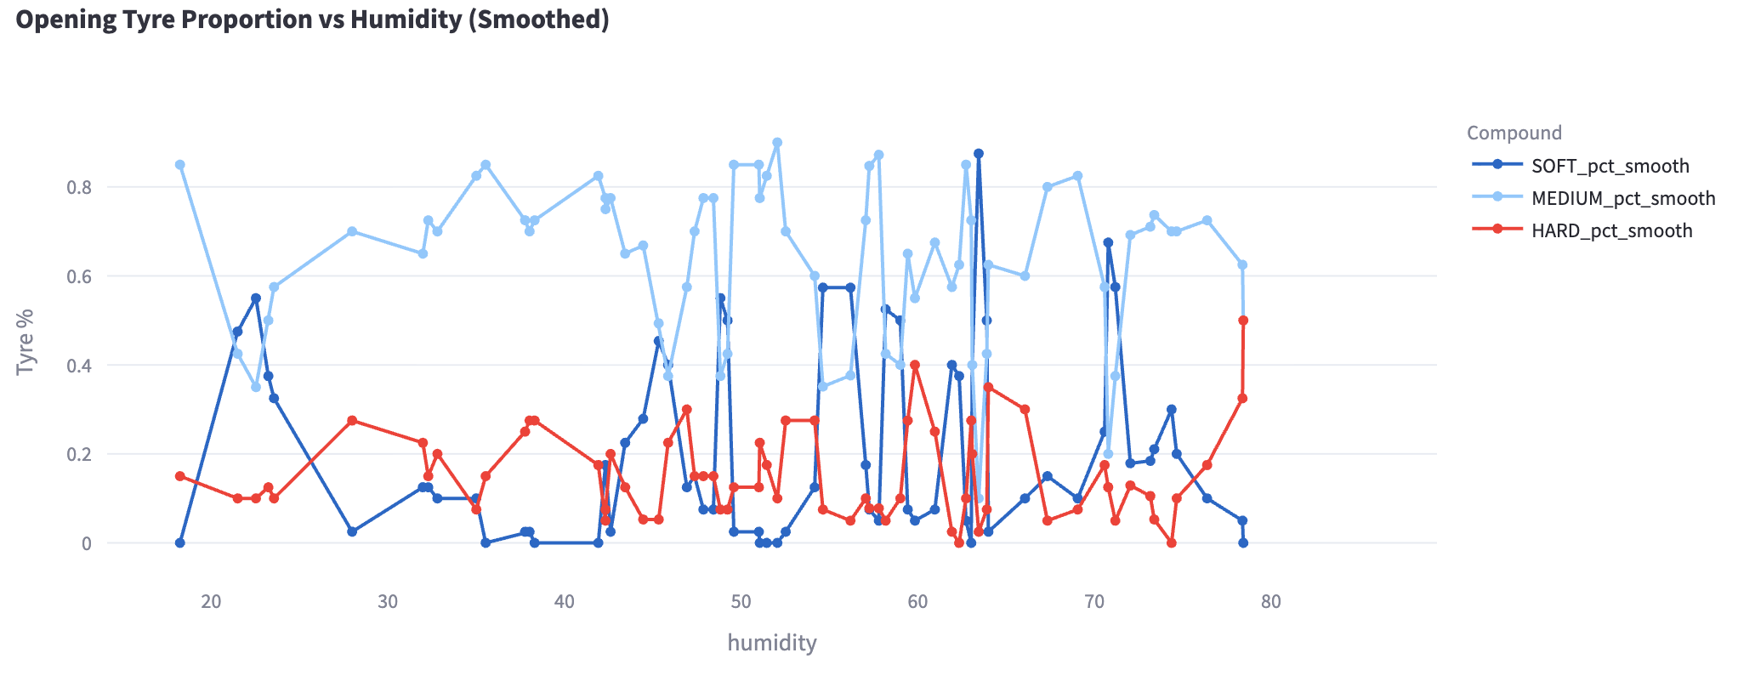
FINDINGS
Medium tyres dominate across all humidity levels, staying consistently high—suggesting teams treat Mediums as the safest, most versatile opening tyre regardless of conditions. This is similar for when plotting tyre proportion against any other weather variables. However, in the humidity plot, we can see that soft tyre usage is highly erratic. It spikes at certain humidity levels but no clear trend, meaning humidity alone doesn’t drive Soft selection. Hard tyres remain rare overall but show slight increases at very high humidity, possibly as a durability hedge.
Overall, the wide oscillations across all compounds show no strong linear relationship between humidity and opening-stint tyre choice. Still, humidity is one of the more influential factors among the weather variables.

Slide 11
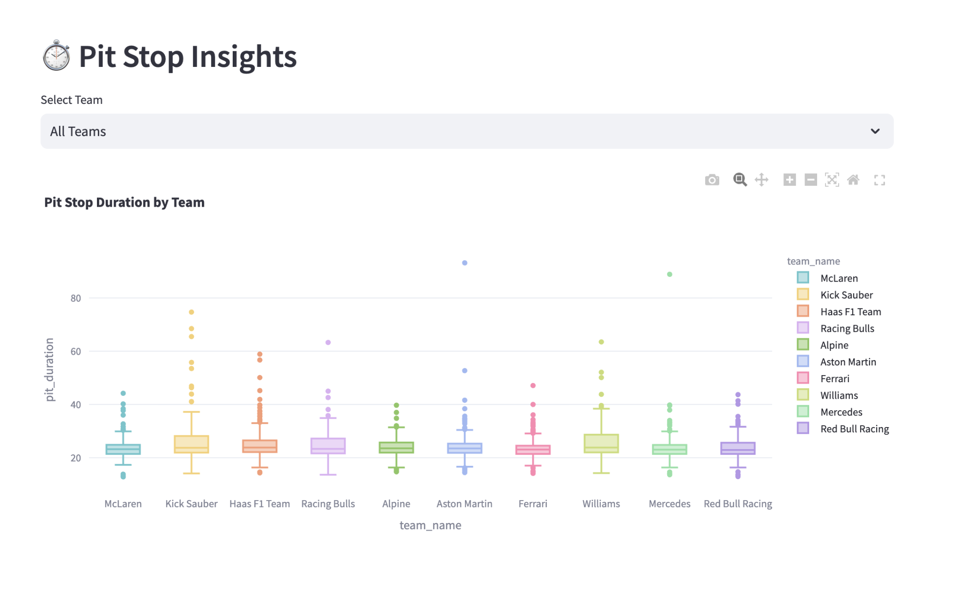
FINDINGS
Pit stop insights
McLaren has the fastest and most consistent pit stops
McLaren’s box is the lowest and tightest, indicating both short durations and low variability.
They have very few high outliers — a sign of strong operational discipline.
Haas, Kick Sauber, and Williams show greater variability
These teams have taller boxes and more extreme outliers, especially above 50–70 seconds.
Their median pit stop times are also slightly higher.
Racing Bulls and Alpine fall in a mid-tier: stable but not the fastest
Their medians are around the mid-20s.
Variability is moderate, with fewer very slow outliers compared to Haas or Kick Sauber.
Mercedes and Red Bull: competitive but with occasional long-duration stops
Typical pit stops hover in the same range as the mid-tier teams.
A couple of very high outliers (~70–90 seconds) suggest race incidents or major issues.

Slide 12
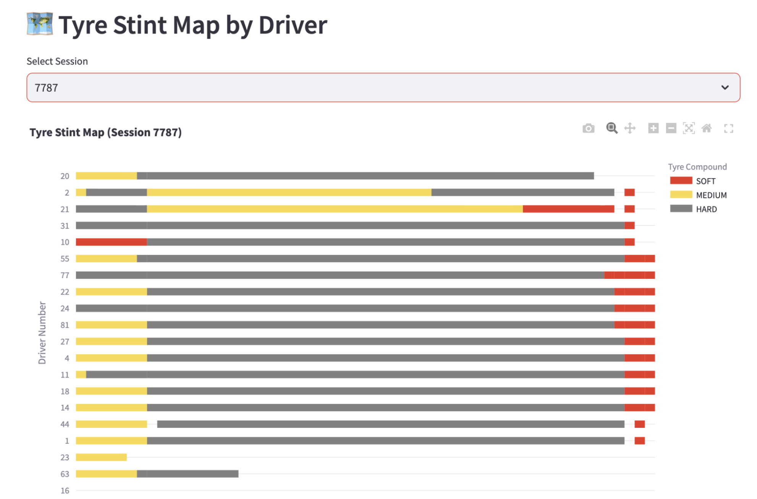
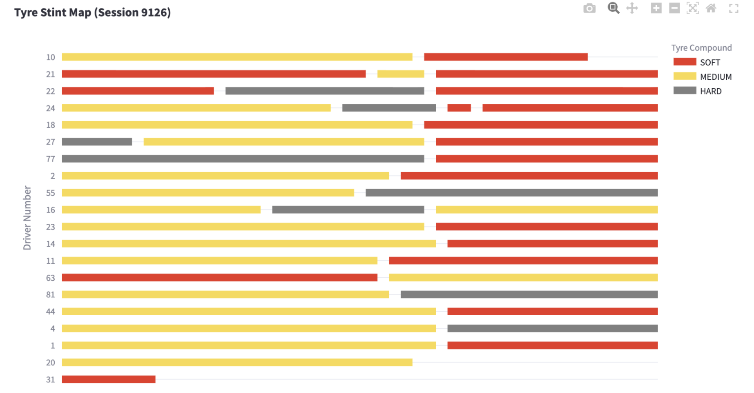
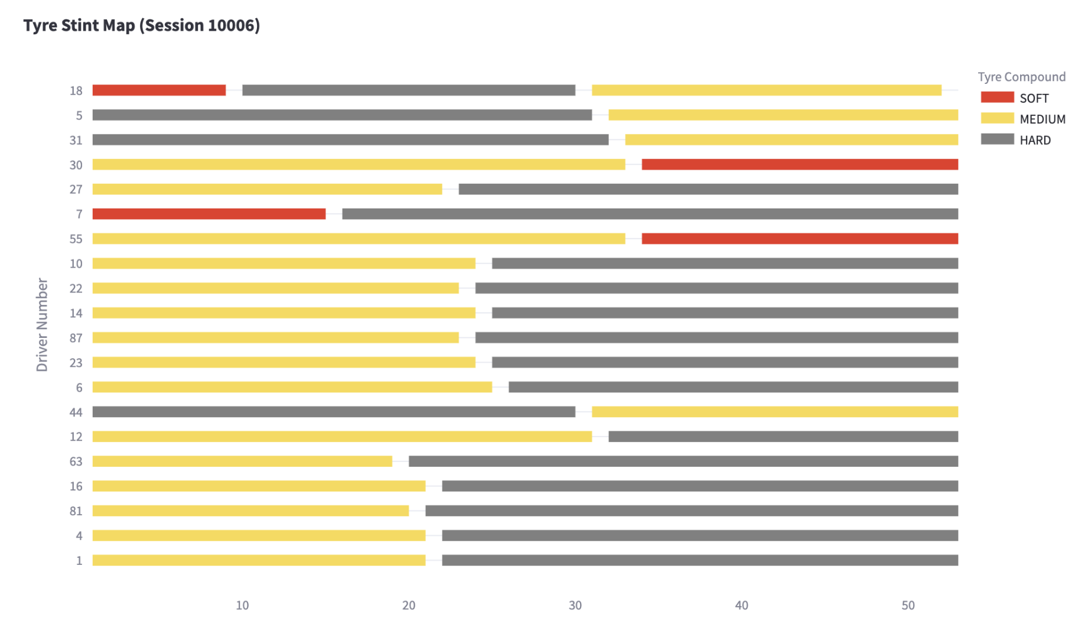
FINDINGS
TYRE STINTS MAP
These plots visualize tyre compound usage by each driver across different race sessions, showing when they switched between different tyres. Each session represents a different race with unique strategies and conditions.
Tyre choices and stint lengths vary notably between sessions, reflecting differences in track surface, temperature, and race dynamics.
Some races show uniform hard-tyre strategies, while others feature frequent compound changes, indicating more aggressive or adaptive pit strategies.
Overall, the maps highlight how teams balance tyre life and performance to suit each race’s specific context.

Slide 13
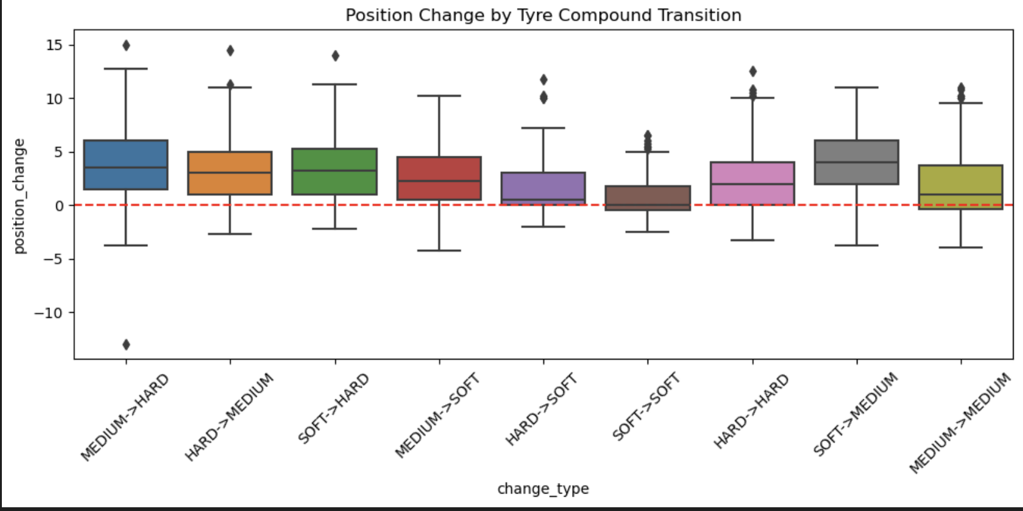
FINDINGS: Position Change by Tyre Compound Transition
>
Medium → Hard tends to yield the strongest net gains
>
Hard → Medium or Hard → Soft often “activates” more pace
>
Soft → Hard usually produces the smallest gains
>
Variability reflects strategic context, not just tyre choice

Slide 14

Q & A
Thank you for listening.
Open Floor for Questions on Methodology, API, or Findings.

